Slide 1
ENGLISH LISTENING SKILLS
LAB THREE (pg. 130)

Slide 2
WHAT IS LISTENING?
It refers to making a conscious MENTAL effort to receive, decode and interpret the oral message.
the process of receiving, constructing meaning from, and responding to spoken and/or non-verbal messages.
– International Listening Association

Slide 3
7 Types of Listening Styles
Discriminative listening
Comprehensive listening
Informational listening
Critical listening
Biased listening
Sympathetic listening
Therapeutic listening and empathetic listening

Slide 4
Discriminative Listening
Discriminative listening is first developed at a very early age
This is the most basic form of listening and does not involve the understanding of the meaning of words or phrases but merely the different sounds that are produced.
In early childhood, for example, a distinction is made between the sounds of the voices of the parents – the voice of the father sounds different to that of the mother.

Slide 5
Discriminative Listening
Example
Imagine yourself surrounded by people who are speaking a language that you cannot understand. Perhaps passing through an airport in another country. You can probably distinguish between different voices, male and female, young and old and also gain some understanding about what is going on around you based on the tone of voice, mannerisms and body language of the other people. You are not understanding what is being said but using discriminative listening to gain some level of comprehension of your surroundings.

Slide 6
Comprehensive Listening
Comprehensive listening requires basic language skills and vocabulary to understand what is being communicated through a speaker’s words.
people use comprehensive listening paired with verbal cues to understand what messages are being communicated to them.

Slide 7
Comprehensive Listening
Comprehensive listening requires basic language skills and vocabulary to understand what is being communicated through a speaker’s words.
people use comprehensive listening paired with verbal cues to understand what messages are being communicated to them.

Slide 8
Comprehensive Listening
Comprehensive listening requires basic language skills and vocabulary to understand what is being communicated through a speaker’s words.
people use comprehensive listening paired with verbal cues to understand what messages are being communicated to them.

Slide 9
Informational listening
Informational listening (or informative listening) is the type of listening people use when they are trying to learn.
Informational listening builds upon basic comprehensive listening and requires a high level of concentration and engagement to understand new concepts and comprehend technical jargon.

Slide 10
Critical listening
Critical listening is the style of listening people use when they are trying to analyze and judge complex information that is being communicated to them.
The word “critical” has multiple meanings, but in this case it simply means that you are evaluating information—not necessarily passing judgment.

Slide 11
Biased listening
Biased listening (or selective listening) is a type of listening behavior demonstrated when someone is just listening for information that they want to hear.

Slide 12
Sympathetic listening
Sympathetic listening is an emotionally-driven type of relationship listening, wherein a listener processes the feelings and emotions of a speaker and tries to provide support and understanding in return.
Sympathetic listening is an important type of listening to use when trying to establish a deep connection with another person, especially when that person is experiencing adversity.

Slide 13
Therapeutic listening and Empathetic listening
Empathetic listening (sometimes referred to as empathic listening) goes a step further than sympathetic listening in that an empathic listener will relate to the speaker’s experience as if it were their own.

Slide 14
WHAT MAKES FOREIGN LANGUAGE LISTENING DIFFICULT
Accent
Pronunicaition
Speed
Contraction & other features of spoken English

Slide 15
How to Overcome the Challenges of listening
Listen the foreign language regularly to familiarize
Listen for the gist
Listening daily or twice a week

Slide 16
Improving English through listening
Maintain a listening vocabulary book. Maintain note of phrases, idioms or expression.
Try to speak what you have just listened to
Imitate the music of the language
Focus on the grammatical structure
Correct pronunciation of the words
Focus on & try to adopt the native stress patterns in words as well as sentences

Slide 17
Improving English through listening
Listen the foreign language regularly to familiarize
Listen for the gist
Listening daily or twice a week

Slide 18
Improving English through listening
Listen the foreign language regularly to familiarize
Listen for the gist
Listening daily or twice a week

Slide 19
International Phonetic Alphabet (IPA) & the Sound of English
an alphabet developed in the 19th century to accurately represent the pronunciation of languages. One aim of the International Phonetic Alphabet (IPA) was to provide a unique symbol for each distinctive sound in a language—that is, every sound, or phoneme, that serves to distinguish one word from another.

Slide 20
International Phonetic Alphabet (IPA) & the Sound of English
IPA enables you to dsicover correct pronunciation
Each IPA symbol denotes or represents a single individual sound
44 Sounds in English

Slide 21
International Phonetic Alphabet (IPA) & the Sound of English
44 Sounds in English
12 vowels
8 diphthongs
24 consonants

Slide 22
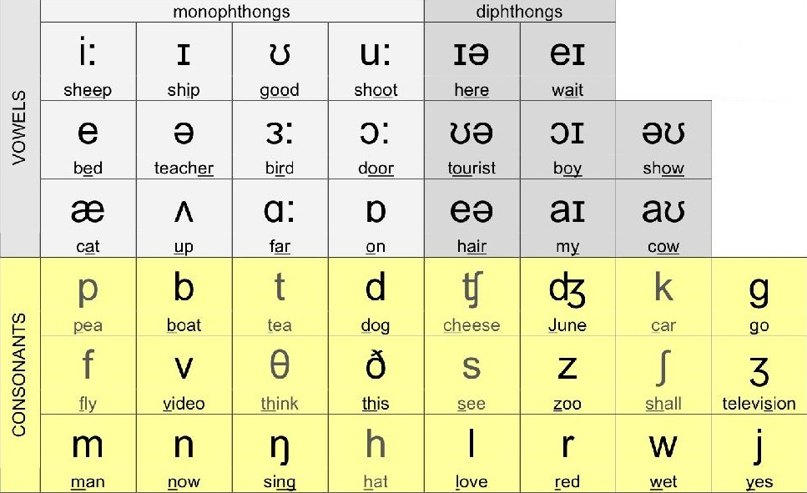
International Phonetic Alphabet (IPA) & the Sound of English

Slide 23
International Phonetic Alphabet (IPA) & the Sound of English
VIDEO DROPPED IN GCR!

Slide 24
EXERCISE
Commonly mispronounce words in Pakistan. (pg. 132)
Check up their correct pronunciation in a dictionary

Slide 25
SPEAKING TASK
Choose any one topic & brainstorm some points. Share your thoughts with the class.
1. Who am I?
For the bright future, you have to work in the present
What annoys you the most & how you deal with this anger then?

